Slide 1
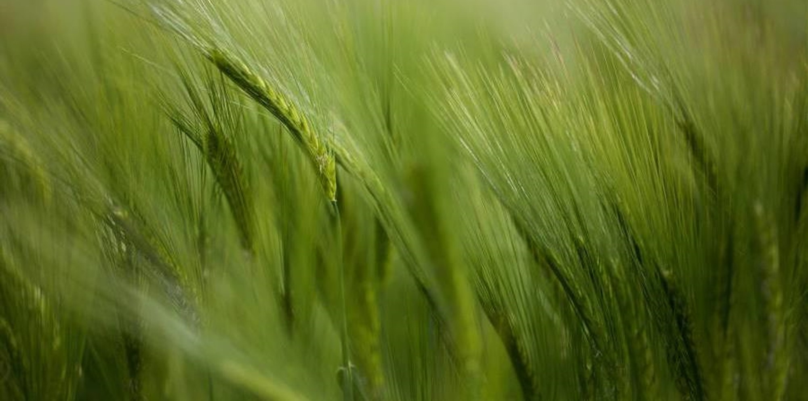
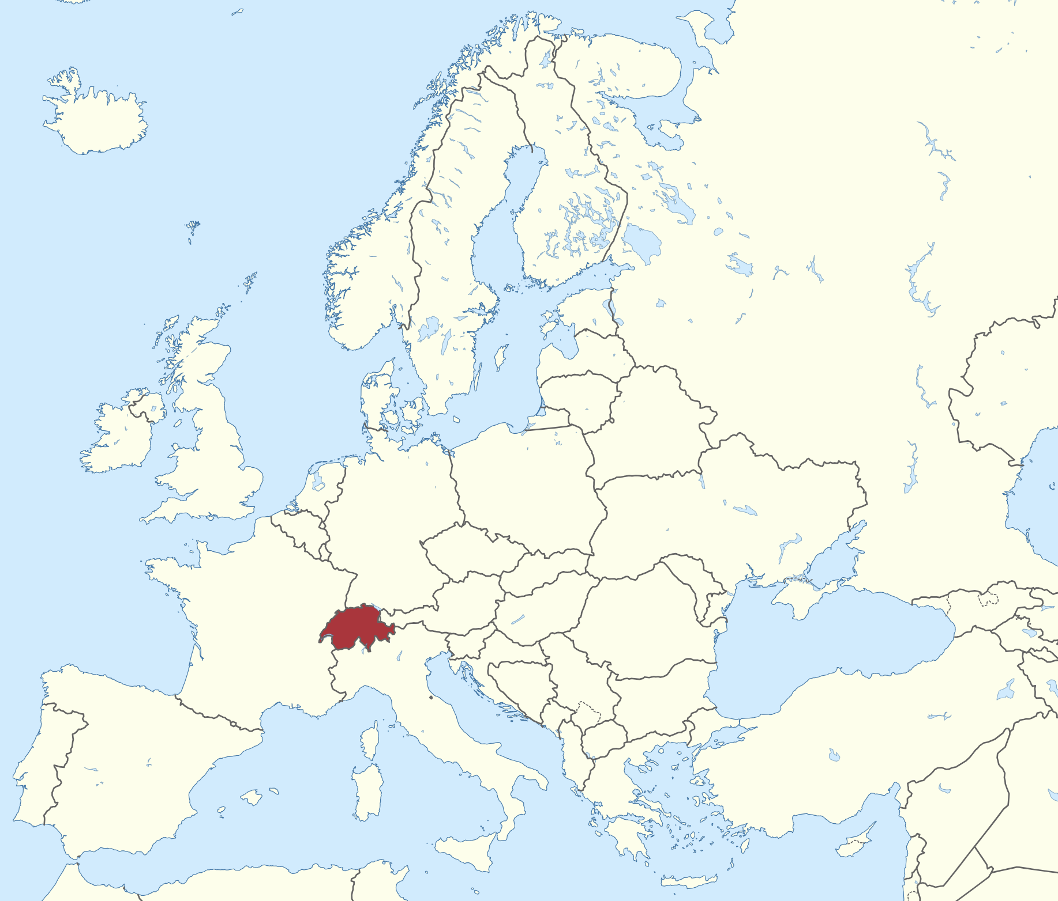
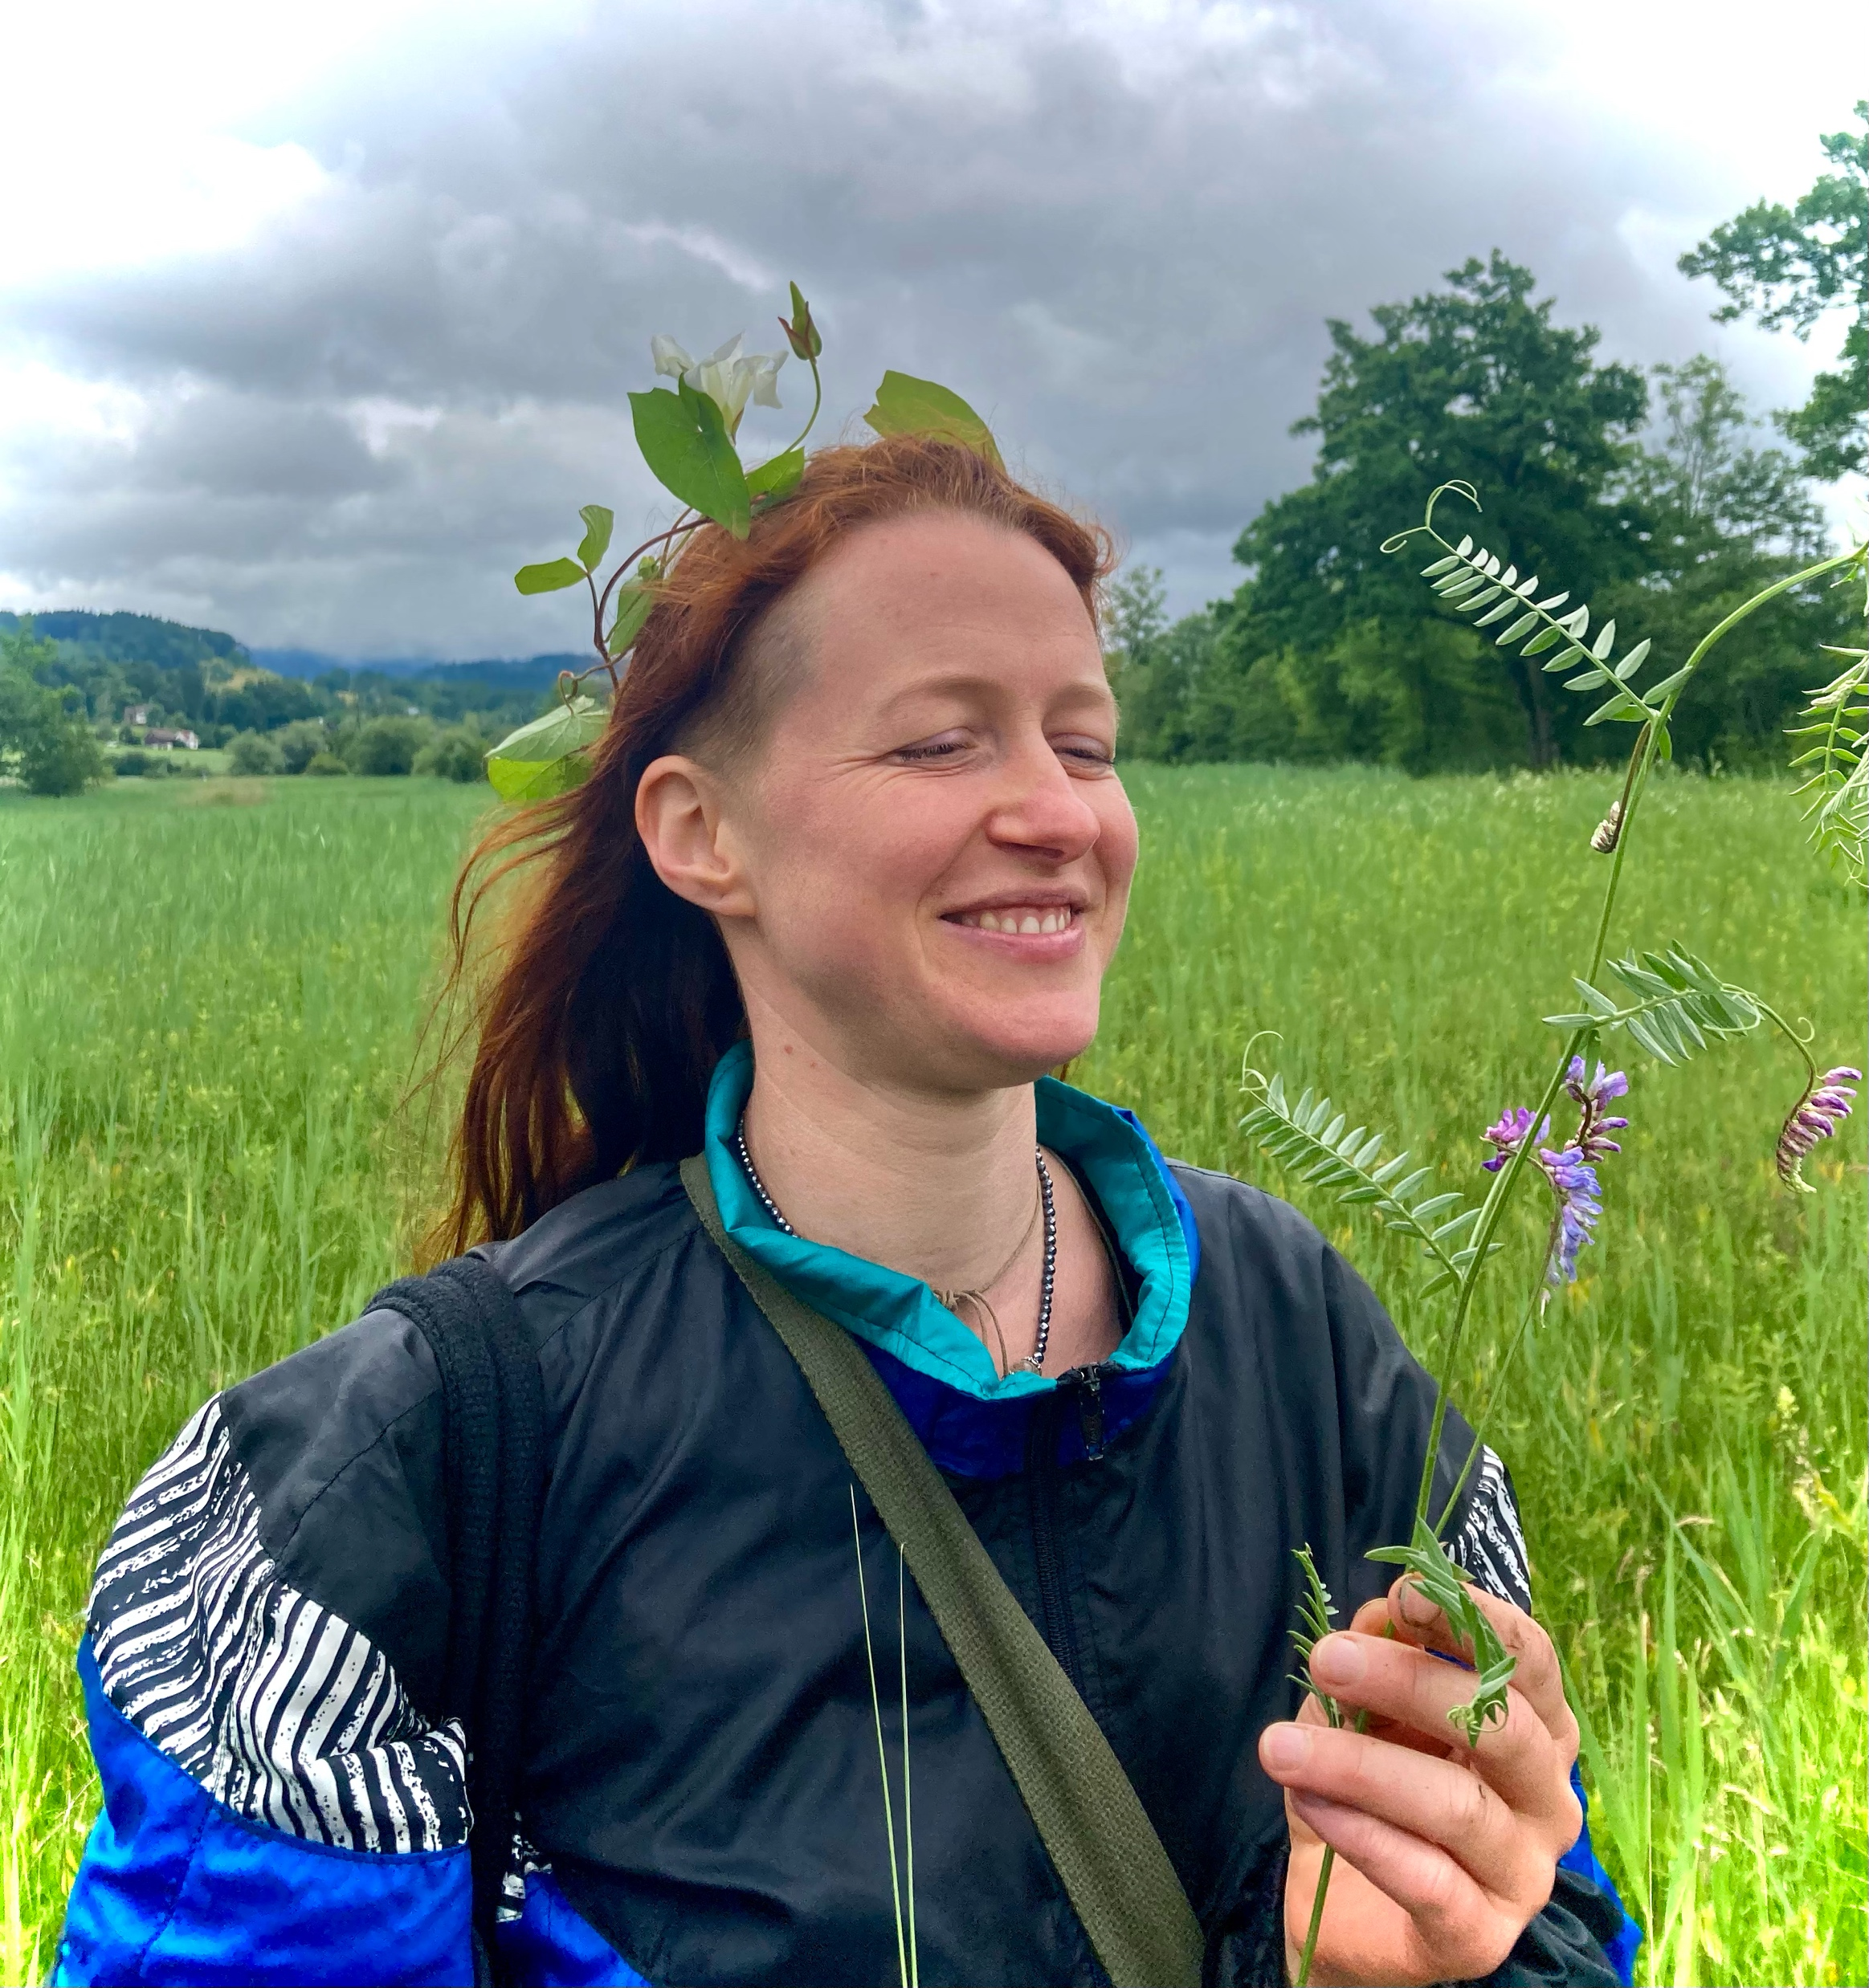
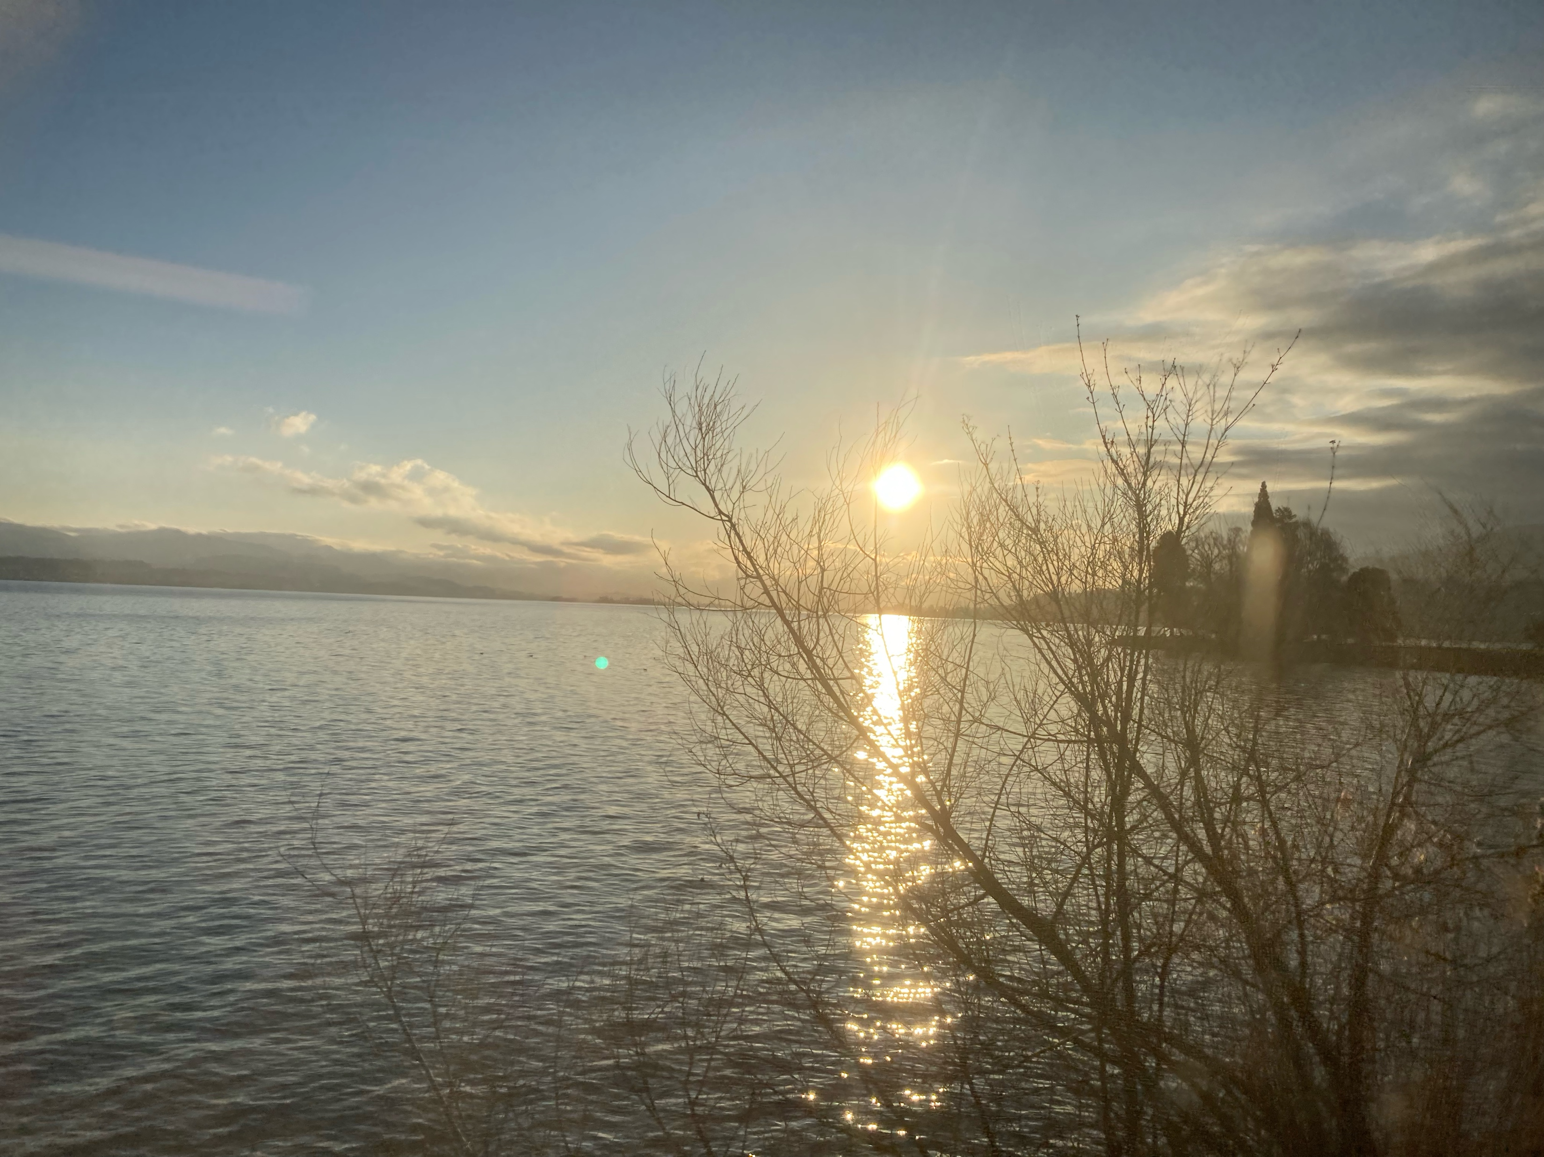



Isabelle Wippl
University: Eastern Switzerland University of Applied Sciences (OST)
Study program: Landscape architecture
Year of study: 2nd year, parttime
City: Basel, Switzerland
Motto for life: Everything I do in my life is true to my nature.
Hobbies: I love my kids, memes, sidequesting with friends and dancing at sunrise
Your expectations from the summer school:
Hope through genuine change makers.
Experiencing self-efficacy and building trust
Where I live, work and study
Karlsruhe
31 August to 11 September 2026

